Slide 1
Wireless LANs
IEEE 802.11
Bluetooth

Slide 2
IEEE 802.11
Covers the physical and data link layers.
Architecture
Defines two kinds of services: basic service set (BSS) and
extended service set (ESS)
BSS
  The building block of a wireless LAN
  A BSS is made of stationary or mobile wireless stations and an optional central base station, known as the access point (AP).
BSS without an AP
  Stand-alone network
  Cannot send data to other BSSs
  Called an Ad hoc architecture
  Stations can form a network without the need of an AP; they can locate one another and agree to be part of a BSS.
BSS with an AP
  Called an infrastructure network

Slide 3
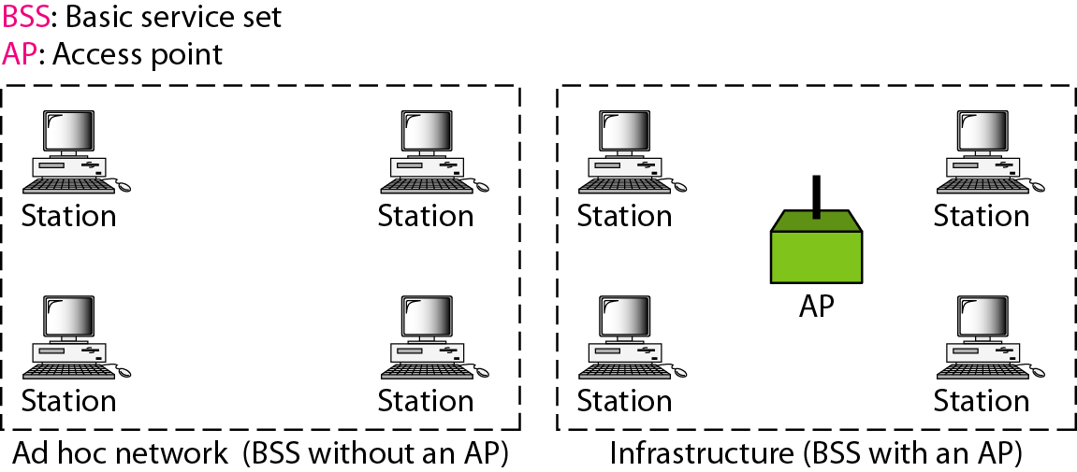
BSSs

Slide 4
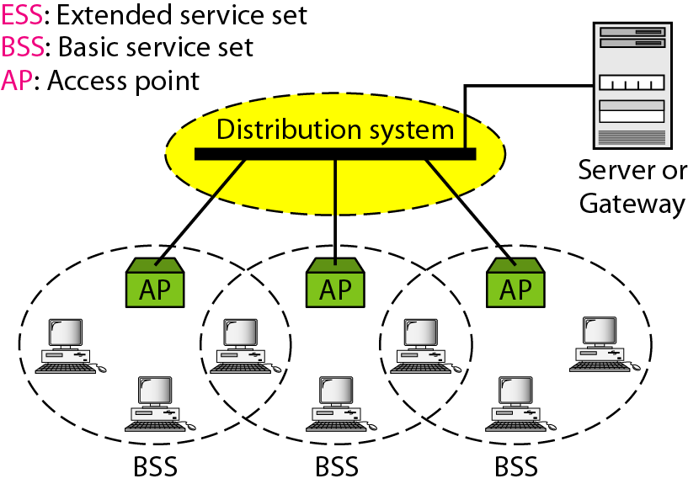
ESS

Slide 5
It is made up of two or more BSSs with APs.
BSSs are connected through a distribution system, usually a wired LAN. The distribution system connects the APs in the BSSs.
Communication between two stations in two different BSSs usually occurs via two APs.
IEEE 802.11 defines three types of stations based on their mobility: no-transition, BSS-transition, and ESS-transition mobility.
- A station with no-transition mobility is either stationary (not moving) or moving only inside a BSS.
- A station with BSS-transition mobility can move from one BSS to another, but the movement is confined inside one ESS.
- A station with ESS-transition mobility can move from one ESS to another.

Slide 6
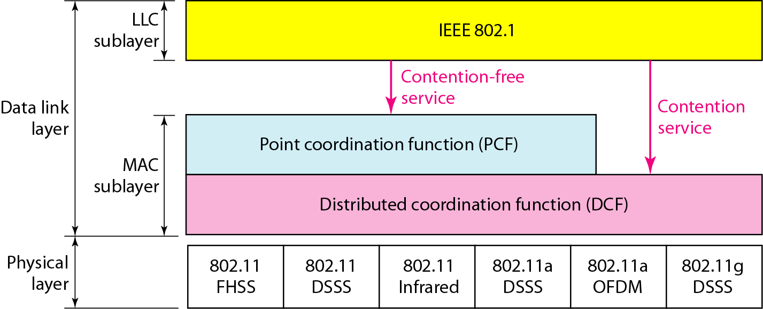
MAC Sublayer
Two MAC sublayers: distributed coordination function (DCF) and point coordination function (PCF).

Slide 7
DCF
DCF uses CSMA/CA as the access method.
Wireless LANs cannot implement CSMA/CD for three reasons:
1. For collision detection a station must be able to send data and receive collision signals at the same time. This can mean costly stations and increased bandwidth requirements.
2. Collision may not be detected because of the hidden station problem. 3. The distance between stations can be great. Signal fading could prevent a station at one end from hearing a collision at the other end.
Network Allocation Vector:
- When a station sends an RTS frame, it includes the duration of time that it needs to occupy the channel.
- The stations that are affected by this transmission create a timer called a network allocation vector (NAV) that shows how much time must pass before these stations are allowed to check the channel for idleness.
- Each time a station accesses the system and sends an RTS frame, other stations start their NAV.
Collision During handshaking – no provision for detection, sender retries

Slide 8

CSMA/CA Flow Chart
DIFS: Distributed Inter Frame Space
SIFS: Short Inter Frame space
RTS: Request To Send
CTS: Clear To Send

Slide 9
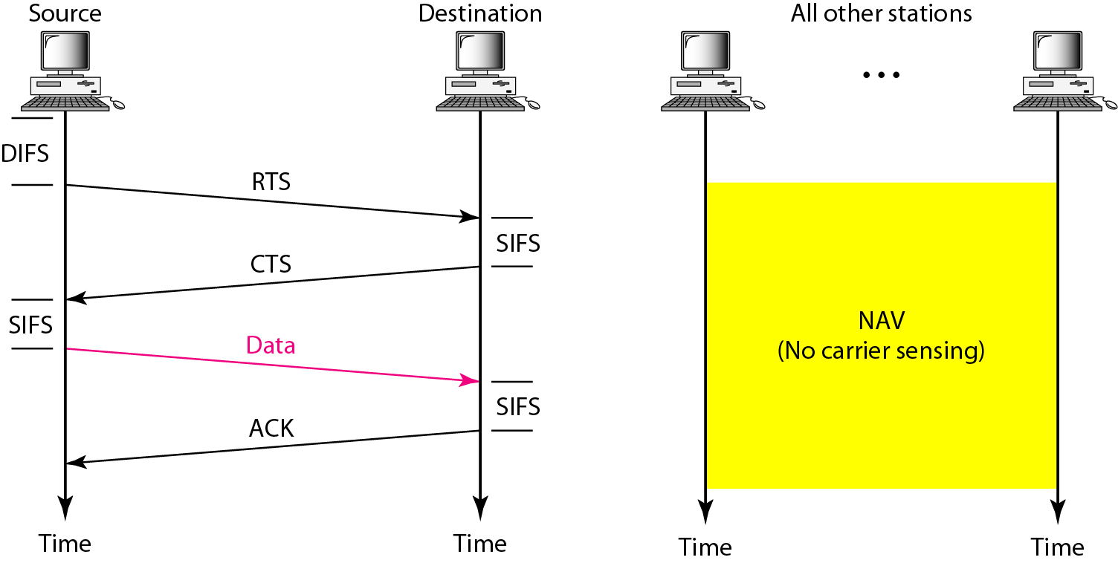
CSMA/CA and NAV
Frame Exchange Time Line

Slide 10
PCF
An optional access method that can be implemented in an infrastructure network.
Used mostly for time-sensitive transmission.
A centralized, contention-free polling access method.
The AP performs polling for stations that are capable of being polled.
To give priority to PCF over DCF, another set of interframe spaces has been defined: PIFS and SIFS.
PIFS (PCF IFS) is shorter than the DIFS → AP using PCF has priority.
Due to the priority of PCF over DCF, stations that only use DCF may not gain access to the medium. To prevent this, a repetition interval has been designed to cover both contention-free (PCF) and contention-based (DCF) traffic.
Repetition interval starts with a special control frame, called a beacon frame. When the stations hear the beacon frame, they start their NAV for the duration of the contention-free period of the repetition interval.
During the repetition interval, the PC (point controller) can send a poll frame, receive data, send an ACK, receive an ACK, or do any combination of these (802.11 uses piggybacking). At the end of the contention-free period, the PC sends a CF end (contention-free end) frame to allow the contention-based stations to use the medium.

Slide 11
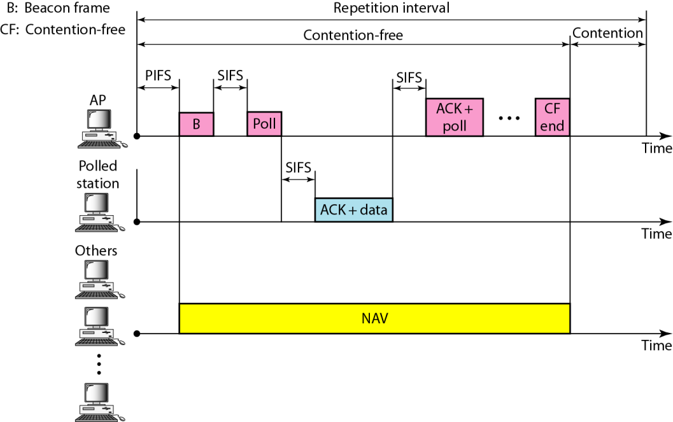

Slide 12

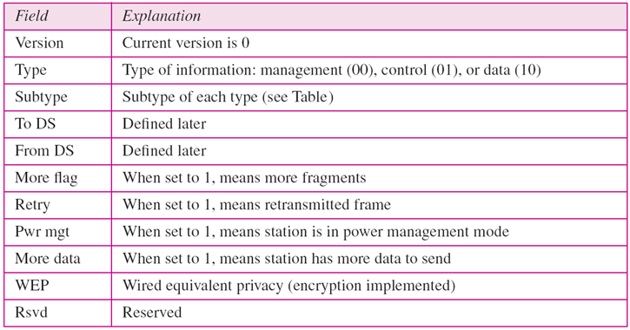
MAC Layer Frame Format

Slide 13
MAC layer frame consists of nine fields:
Frame Control (FC): it is 2 bytes long and defines the type of frame and some control information.
D: In all frame types except one, this field defines the duration of the transmission that is used to set the value of NAV. In one control frame, this field defines the ID of the frame.
Addresses: There are four address fields, each 6 bytes long. The meaning of each address field depends on the value of the To DS and From DS sub fields.
Sequence Control (SC): defines the sequence number of the frame to be used in flow control.
Frame body: can be between 0 and 2312 bytes, contains infor-mation based on the type and the subtype defined in the FC field.
Frame Check Sequence (FCS): The FCS field is 4 bytes long and contains a CRC-32 error detection sequence.

Slide 14
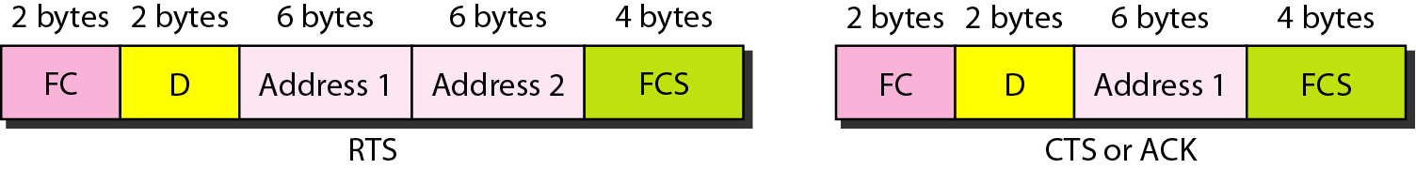
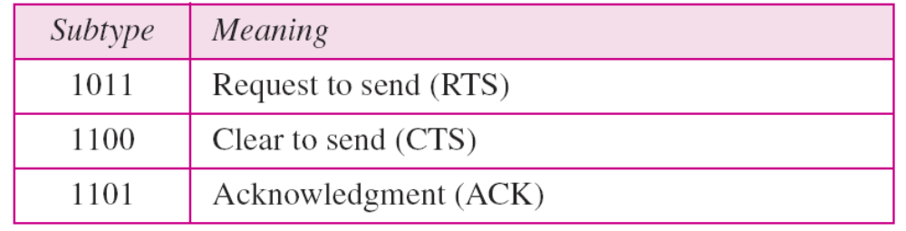
Frame types
Three categories of frames
Management frames for initial communication between stations and APs.
Control frames for accessing the channel and acknowledging frames, shown in below fig.s.
Data frames are used for carrying data and control information.

Slide 15
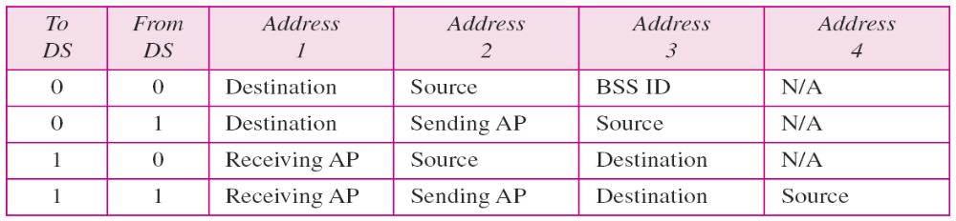
Addressing Mechanism
The IEEE 802.11 addressing mechanism specifies four cases, defined by the value of the two flags in the FC field, To DS and From DS.
Each flag can be either 0 or 1, resulting in four different situations.
The interpretation of the four addresses (address 1 to address 4) in the MAC frame depends on the value of these flags.
Note that address 1 is always the address of the next device. Address 2 is always the address of the previous device. Address 3 is the address of the final destination station if it is not defined by address 1. Address 4 is the address of the original source station if it is not the same as address 2.

Slide 16
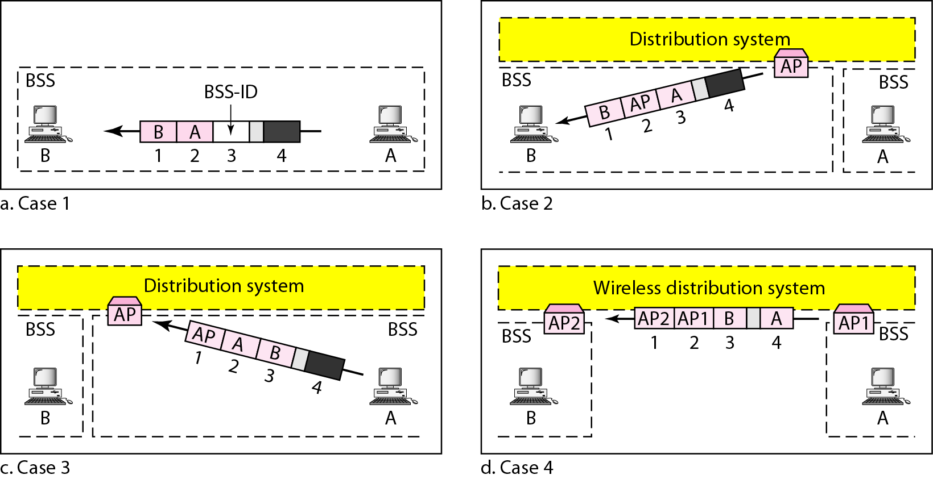

Slide 17
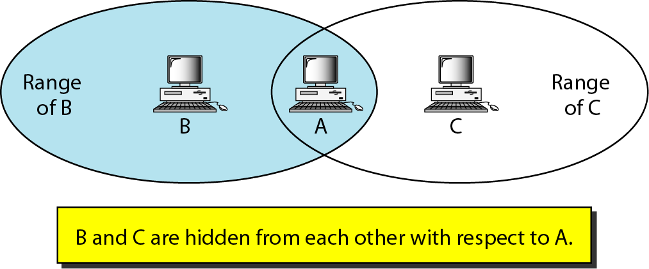
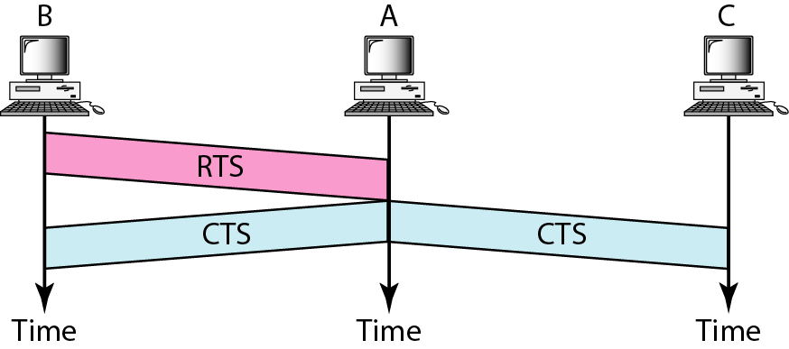
Hidden Station Problem

Slide 18
Station B has a transmission range shown by the left oval (sphere in space); every station in this range can hear any signal transmitted by station B. Similarly, station C has a transmission range shown by the right oval. Station C is outside the transmission range of B; like wise, station B.
Station A, however, is in the area covered by both B and C; it can hear any signal transmitted by B or C.
Assume that station B is sending data to station A. In the middle of this transmission, station C also has data to send to station A. As station C is out of B's range, transmissions from B can not reach C. Therefore C thinks the medium is free and sends its data to A, which results in a collision at A because this station is receiving data from both B and C.
In this case, we say that stations B and C are hidden from each other with respect to A.
The use of the handshake frames (RTS and CTS) can solve this problem. Figure shows that the RTS message from B reaches A, but not C. However, the CTS message sent by A, which contains the duration of data transmission from B to A reaches C.

Slide 19
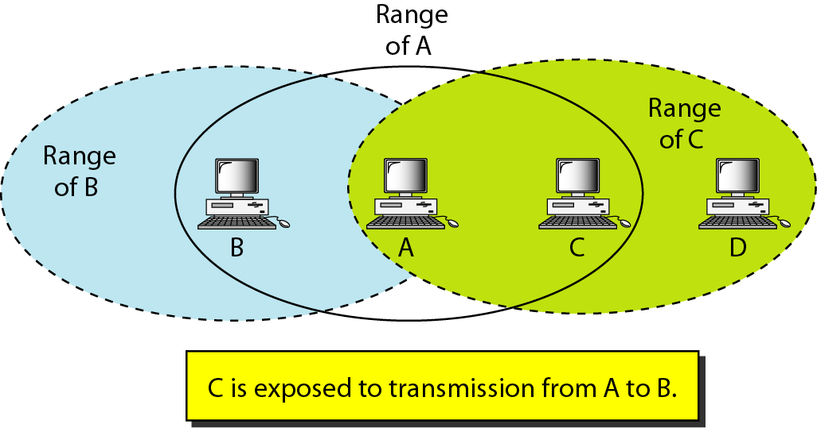
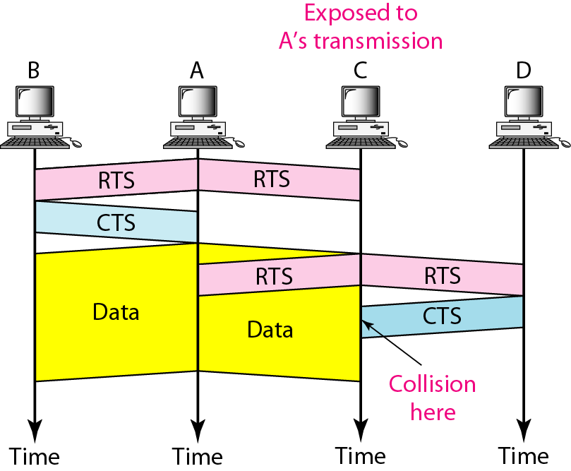
Exposed Station Problem

Slide 20
In this problem a station refrains from using a channel when it is, in fact, available.
Station A is transmitting to station B. Station C has some data to send to station D, which can be sent without interfering with the transmission from A to B. However, station C is exposed to transmission from A; it hears what A is sending and thus refrains from sending. In other words, C is too conservative and wastes the capacity of the channel.
The handshaking messages RTS and CTS cannot help in this case. Station C hears the RTS from A, but does not hear the CTS from B. Station C, after hearing the RTS from A, can wait for a time so that the CTS from B reaches A; it then sends an RTS to D to show that it needs to communicate with D. Both stations B and A may hear this RTS, but station A is in the sending state, not the receiving state. Station B, however, responds with a CTS. The problem is here. If station A has started sending its data, station C cannot hear the CTS from station D because of the collision; it cannot send its data to D. It remains exposed until A finishes sending its data.

Slide 21
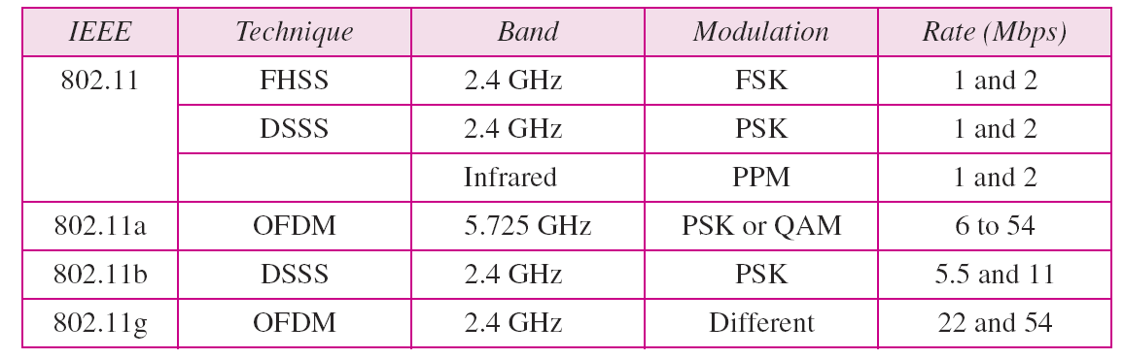
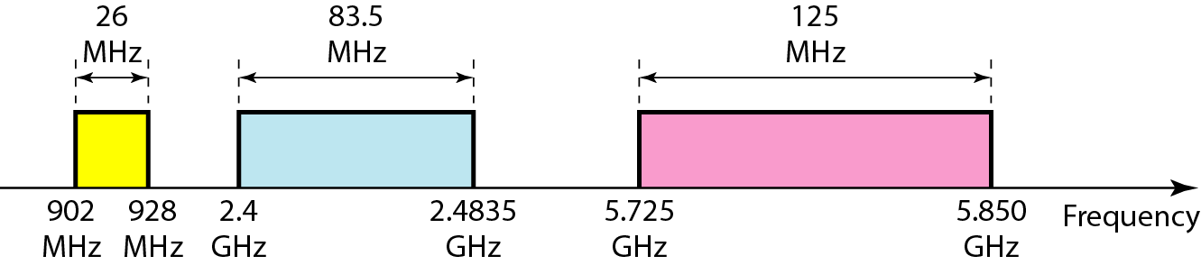
Physical Layer
All implementations, except the infrared, operate in industrial, scientific, and medical (ISM) band which defines three unlicensed bands in three ranges 902-928 MHz, 2.400-4.835 GHz, and 5.725-5.850 GHz.

Slide 22
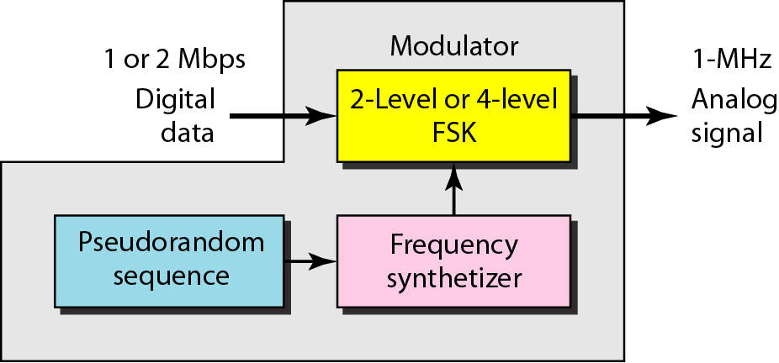
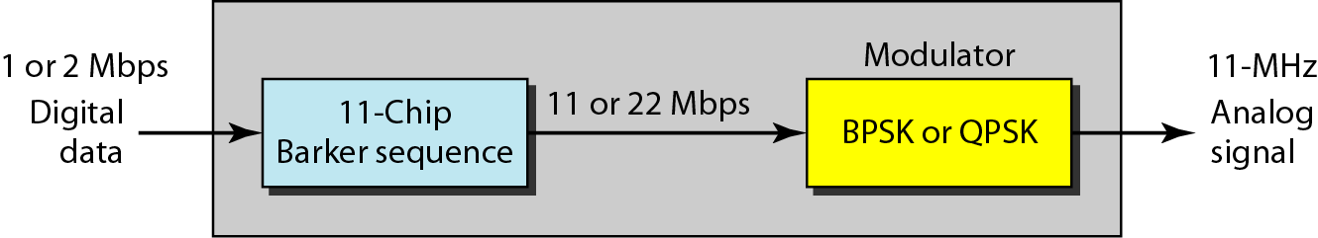
IEEE 802.11 FHSS
Uses the frequency-hopping spread spectrum.
FHSS uses the 2.4-GHz ISM band.
The band is divided into 79 sub bands of 1 MHz (and some guard bands).
IEEE 802.11 DSSS
Uses the direct sequence spread spectrum.
DSSS uses the 2.4-GHz ISM band.
FHSS
DSSS

Slide 23
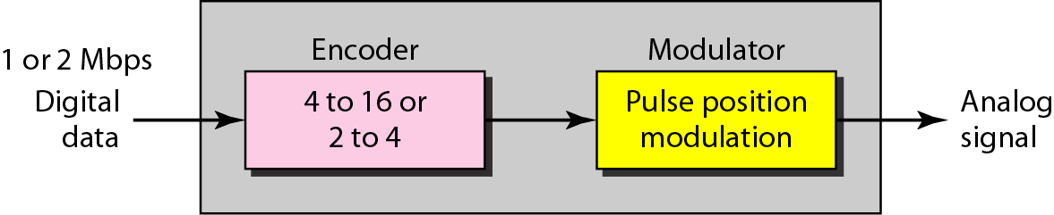
IEEE 802.11 Infrared
Uses infrared light in the range of 800 to 950nm.
The mapped sequences are converted to optical signals; the presence of light specifies 1, the absence of light specifies 0.
IEEE 802.11a OFDM
Orthogonal frequency division multiplexing (OFDM) method for signal generation in a 5-GHz ISM band.
All the sub bands are used by one source at a given time.
The common data rates are 18Mbps (PSK) and 54Mbps (QAM).
IEEE 802.11g
Defines forward error correction and OFDM using the 2.4-GHz ISM band.
22- or 54-Mbps data rate.
Backward-compatible with802.11b, but the modulation technique is OFDM.

Slide 24
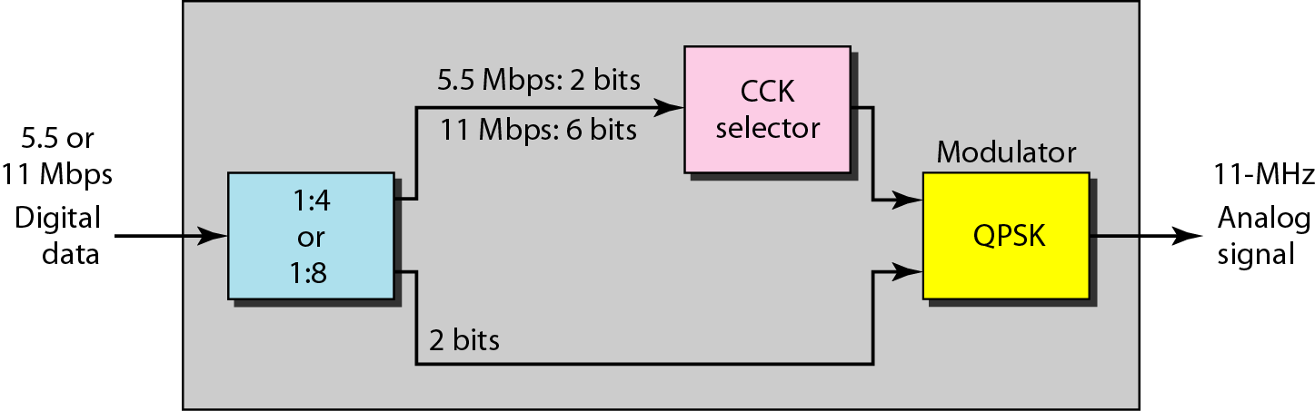
IEEE 802.11b DSSS
Describes the high-rate DSSS (HR-DSSS) method for signal generation in the 2.4-GHz ISM band.
HR-DSSS is similar to DSSS except for the encoding method, which is calledcomplementary code keying (CCK).
Defines four data rates:1, 2, 5.5, and 11Mbps.
The first two use the same modulation techniques as DSSS.

Slide 25
Bluetooth
Bluetooth is a wireless LAN technology designed to connect devices of different functions such as telephones, notebooks, computers, cameras, printers, coffee makers, and so on.
A Bluetooth LAN is an ad hoc network, which means that the network is formed spontaneously.
Bluetooth technology – IEEE 802.15.
Bluetooth device has a built-in short range radio transmitter, data rate is 1Mbps with 2.4-GHz bandwidth. A possibility of interference with IEEE 802.11b.
Architecture
Bluetooth defines two types of networks: piconet and scatternet.
Piconet
A Bluetooth network is called a piconet, or a smallnet.
It can have up to eight stations, one of which is called the primary; the rest are called secondaries.
All the secondary stations synchronize their clocks and hopping sequence with the primary. Note that a piconet can have only one primary station. The communication between the primary and the secondary can be one-to-one or one-to-many.

Slide 26
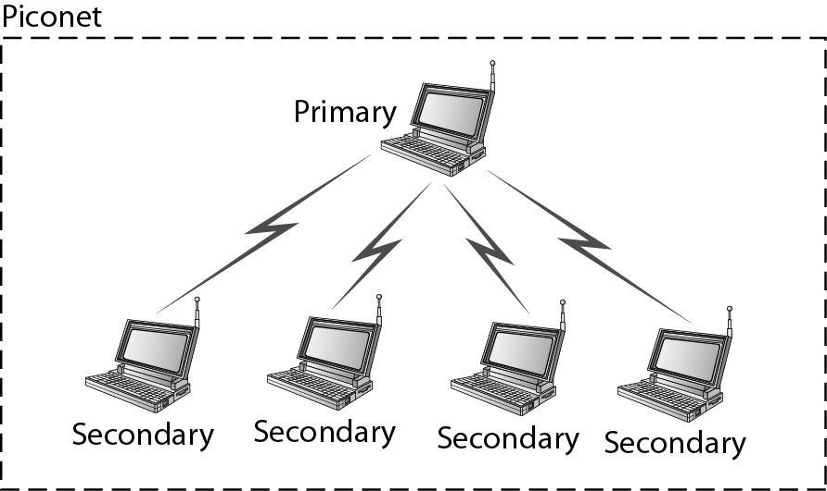
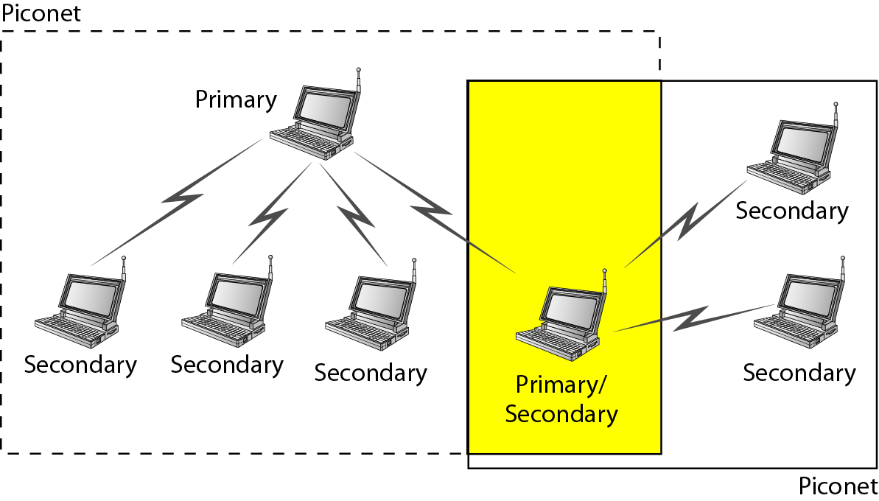
Scatternet
Piconets can be combined to form a scatternet.
A secondary station in one piconet can be the primary in another piconet. This station can receive messages from the primary in the first piconet (as a secondary) and, acting as a primary, deliver them to secondaries in the second piconet.
A station can be a member of two piconets.
Scatternet

Slide 27
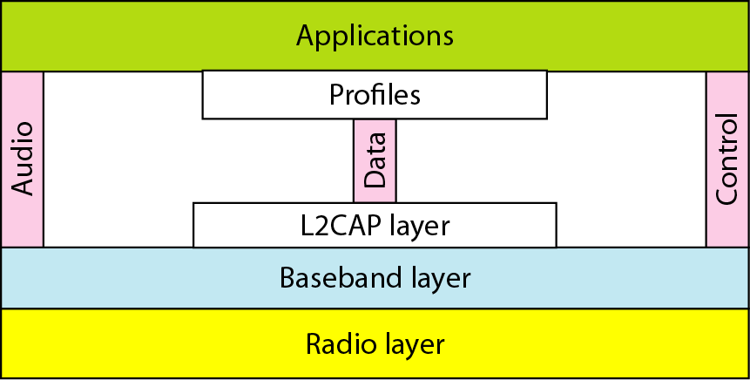
Bluetooth Layers
Radio Layer
  roughly equivalent to the physical layer of the Internet model.
  Bluetooth devices are low-power and have a range of 10m.
  2.4 GHz ISM band divided into 79 channels of 1 MHz each.
  FHSS: Bluetooth hops 1600 times per second, dwell time (the time a device uses a frequency before it hops to another frequency) is 625 μsec (= 1/1600 sec)
  Modulation: GFSK (FSK with Gaussian bandwidth filtering).

Slide 28
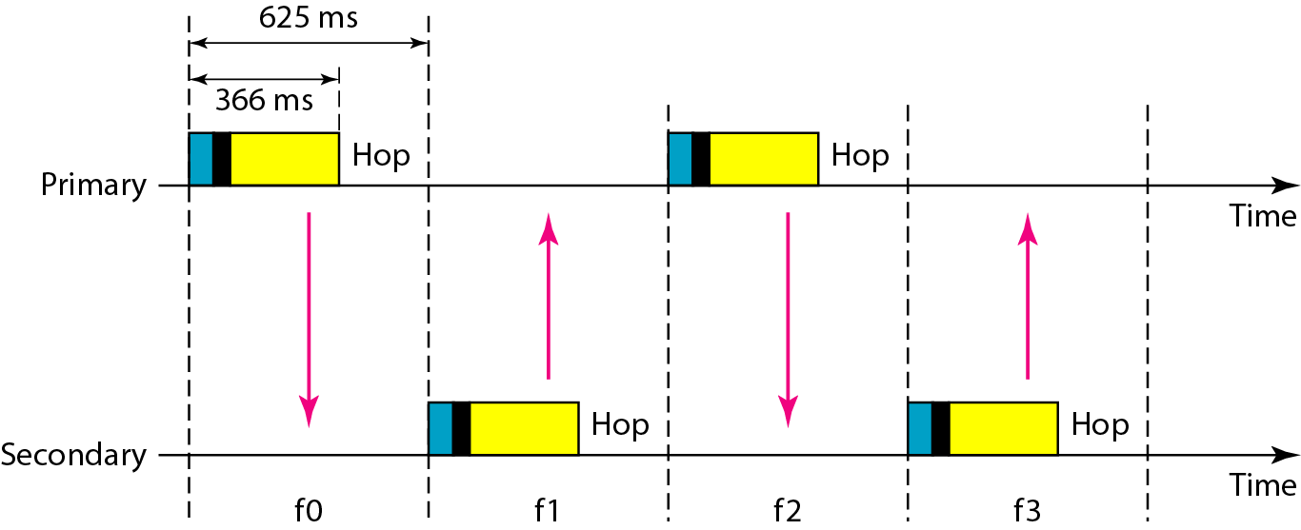
Baseband Layer
  roughly equivalent to MAC sublayer in LANs.
  The access method is TDMA .
  The length of a time slot is exactly the same as the dwell time, 625 μs.
  Uses a form of TDMA, TDD-TDMA (time division duplex TDMA): half-duplex communication.
  Single-secondary communication : The primary uses even numbered slots (0, 2, 4, ...); the secondary uses odd-numbered slots (1, 3, 5, ...). In slot 0, the primary sends, and the secondary receives; in slot 1, the secondary sends, and the primary receives. The cycle is repeated.

Slide 29
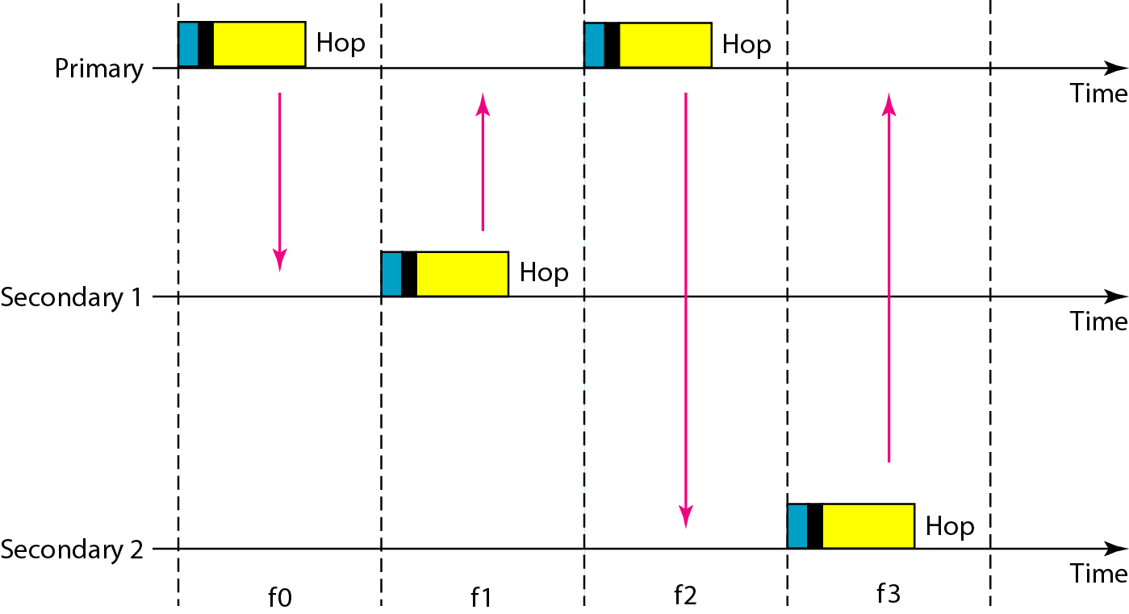
  Multiple-secondary communication: The primary uses the even-numbered slots, but a secondary sends in the next odd-numbered slot if the packet in the previous slot was addressed to it. All secondaries listen on even- numbered slots, but only one secondary sends in any odd-numbered slot. The cycle continues.

Slide 30
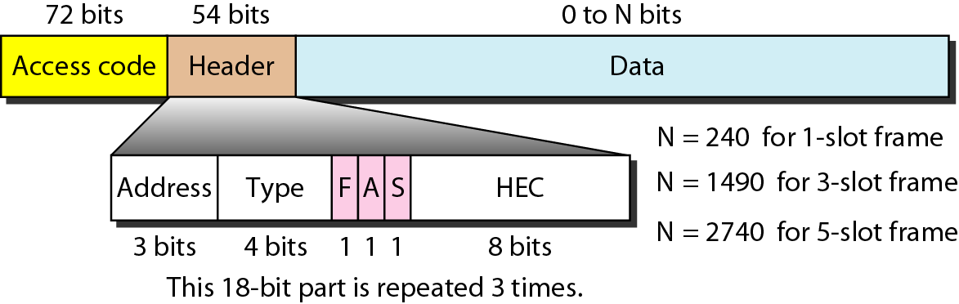
Physical links: Two types of links can be created between a primary and a secondary: SCO links and ACL links.
  SCO (synchronous connection-oriented): used when avoiding delay is more important than integrity (error-free delivery). It is used for real time audio.
  ACL (asynchronous connectionless link): used when data integrity is more important than avoiding latency.
Frame format
- frame can be three types: one-slot, three-slot, or five-slot.
- access code: synchronization bits and identifier of the primary

Slide 31
1. Address: define up to seven secondaries (l to 7). If the address is zero, it is used for broadcast communication from the primary to all secondaries.
2. Type: defines the type of data coming from the upper layers.
3. F: flow control. When set (1), it indicates that the device is unable to receive more frames (buffer is full).
4. A: acknowledgment. Bluetooth uses Stop-and-Wait ARQ.
5. S: sequence number.
6. HEC: header error correction is a checksum to detect errors in each 18- bit header section.

Slide 32
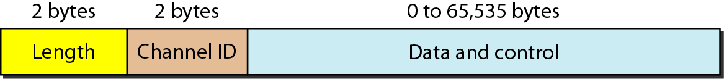
L2CAP (Logical Link Control and Adaptation Protocol)
  Roughly equivalent to LLC sublayer in LANs.
  used for data exchange on an ACL link; SCO channels do not use L2CAP.
  Format of the data packet at this level is shown in fig.
  Length field defines the size of the data, coming from the upper layers. The channel ID (CID) defines a unique identifier for the virtual channel created at this level.
  It has specific duties:
  Multiplexing – accepts data from multiple upper-layer protocols.
  Segmentation and reassembly – to handle large size application layer packets.
  QoS – allows stations to define QoS, otherwise best-effort service.
  Group management – allow devices to create multicast groups.

